Slide 1

LOAN ELIGIBILITY PREDICTION WEBAPP
Team Members
G_ID | NAMES
2216126 | AYESHA SHAHANAZ.
2216129 | B. VENKATA LAKSHMI VYSHNAVI.
2216141 | SHIVANI POOSALA.
2216130 | RAHUL RAVALA.
2216107 | SREEJA MANDALA.

Slide 2
INTRODUCTION
Loans are the core business of banks.
The loan companies grant a loan after an intensive process of verification and validation.
Model to predict if an applicant is able to repay the lending company or not.
Immediate and easy way to choose the deserving applicants it can be provide special advantage for bank.
The main portion the bank assent is directly earn the profit.
Today many banks /financial companies approve loans regress process of verification and validation.
This is a classification problem in which we need to classify whether the loan will be approved or not. classification refers to a predictive modeling problem where a class label is predicted for a given example of input data. A few examples of classification problems are Spam Email detection, Cancer detection, Sentiment Analysis, etc.

Slide 3
NEED OF THE PROJECT
Done with Introduction? Start by telling us the need of the project in real time scenario
The primary goal of this analysis was to increase and use various models to predict the target variable.
A system called ‘Loan Eligibility Prediction system’ that helps the organization in making right decision to approve or reject the loan request of the customers.
Loan Eligibility Prediction system is a system which provides you a interface for loan approval to the applicants application of loan.
Applicants provides the system about their personal information and according to their information system gives his status of availability of loan.

Slide 4
OBJECTIVES
For a project to be good it must have a strong objectives. Type your objectives in here.
The main objective is to predict whether assigning the loan to particular person.
Mainly Two Objectives :
Identification of Relevant Attributes.
Determining the Best Model.
It included some point about this Loan Status prediction.
The main objective for this dataset is using machine learning techniques to predict loan payments.

Slide 5
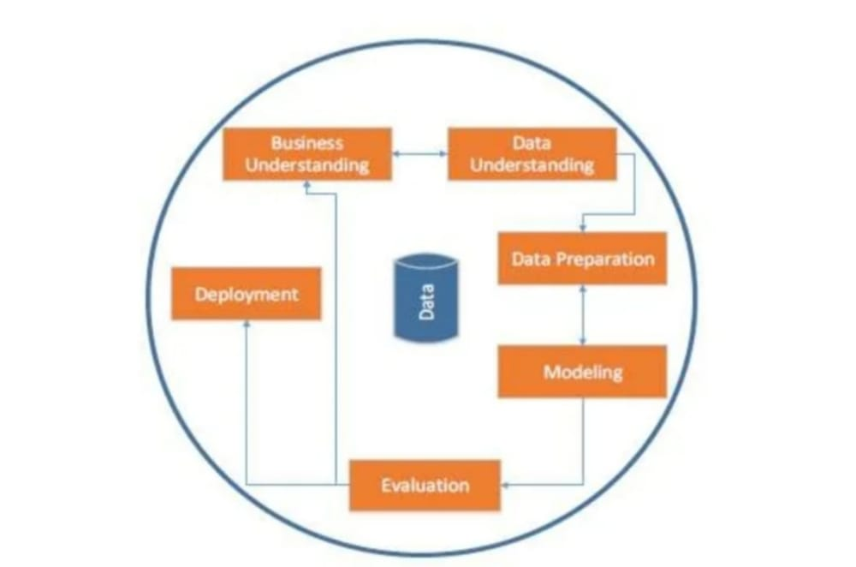
METHODOLOGY
Explain the methods and concepts used in your project
The data was then passed to various models to find the best accuracy in the training set.
Each model’s training was fit using –
DECISION TREE.
RANDOM FOREST.
NAVIE_BAYES.
LOGISTIC REGRESSION.
XG BOOST.
SVM.
KNN.

Slide 6
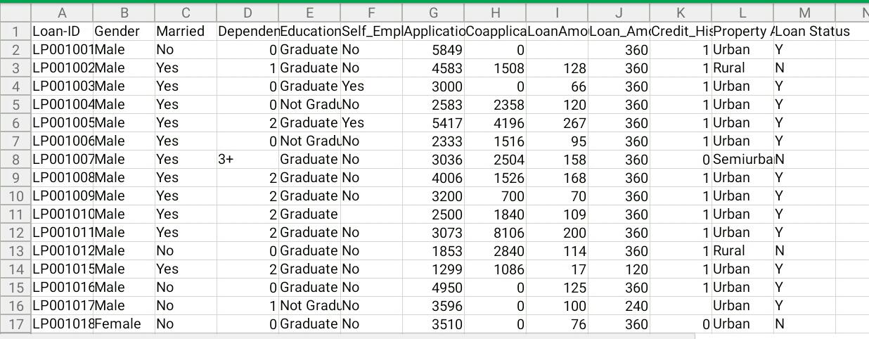
DATASET
Give a brief description of your dataset here along.
Loan ID : Unique Loan ID.
Gender : Male/ Female.
Married : Applicant married (Y/N).
Dependents : Number of dependents.
Education : Applicant Education (Graduate/ Not Graduate).
Self Employed : Self employed (Y/N).
Application Income : Application income.
Co-application Income : Co-application income.
Loan Amount : Loan amount in thousands.
Loan Amount Term : Term of loan in months.
Credit History : credit history meets guidelines(Y/N).
Property Area : Urban/ Semi Urban/ Rural.
Loan Status : Loan approved (Y/N) this is the target variable.

Slide 7
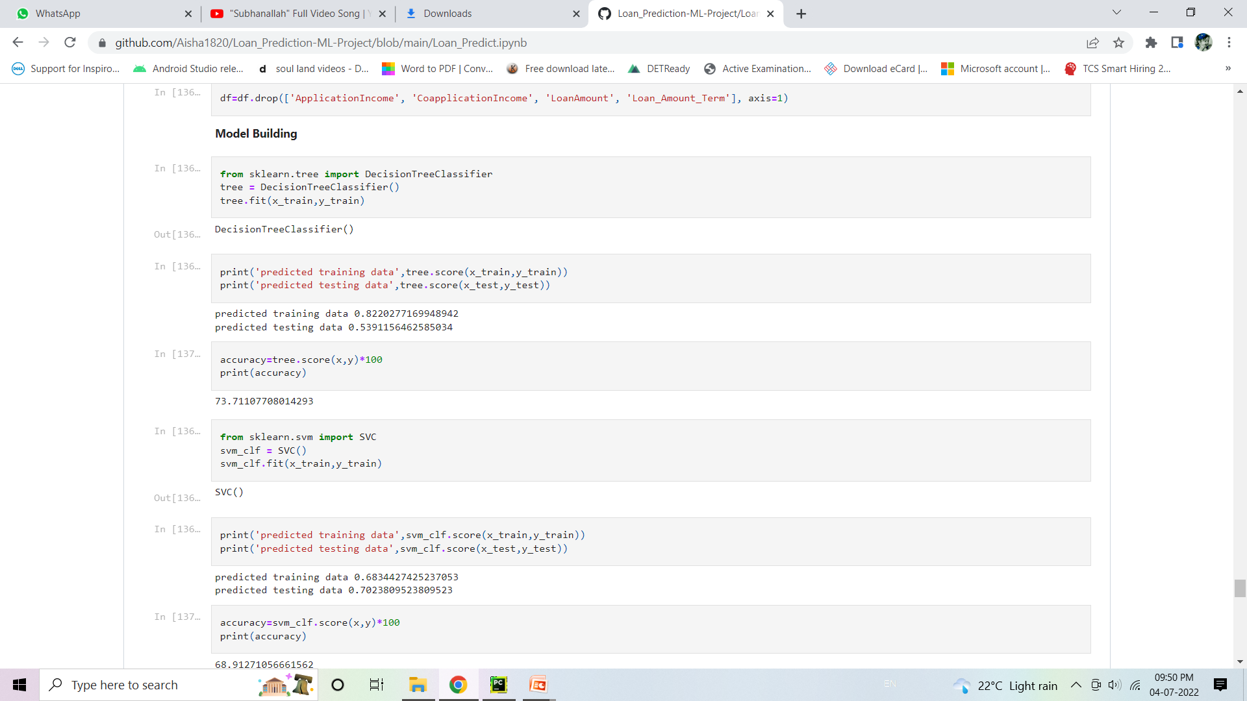
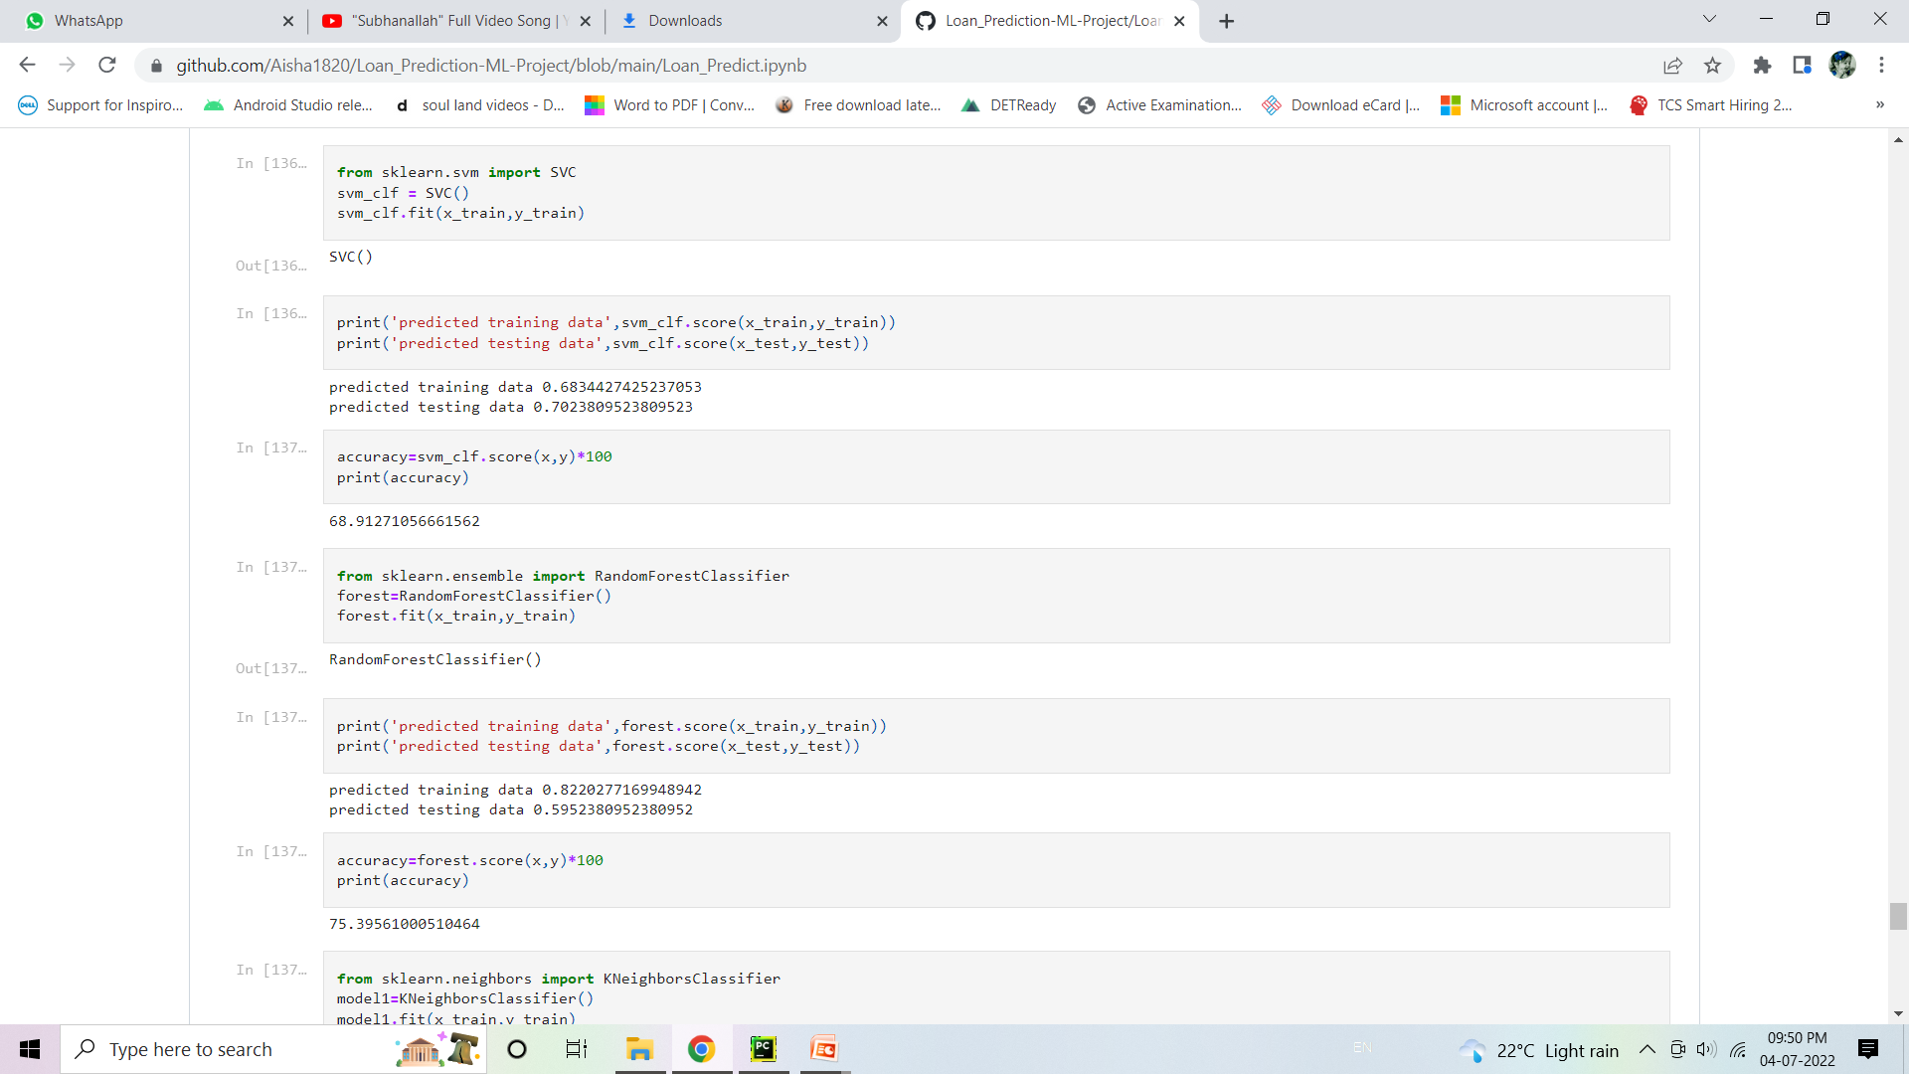
CREATING THE MODEL
Add information regarding creation of model i. e describe each step clearly in each slide(Prototyping).
This type of dataset needs a classification approach.
DECISION TREE:
SUPPORT VECTOR MACHINE:

Slide 8
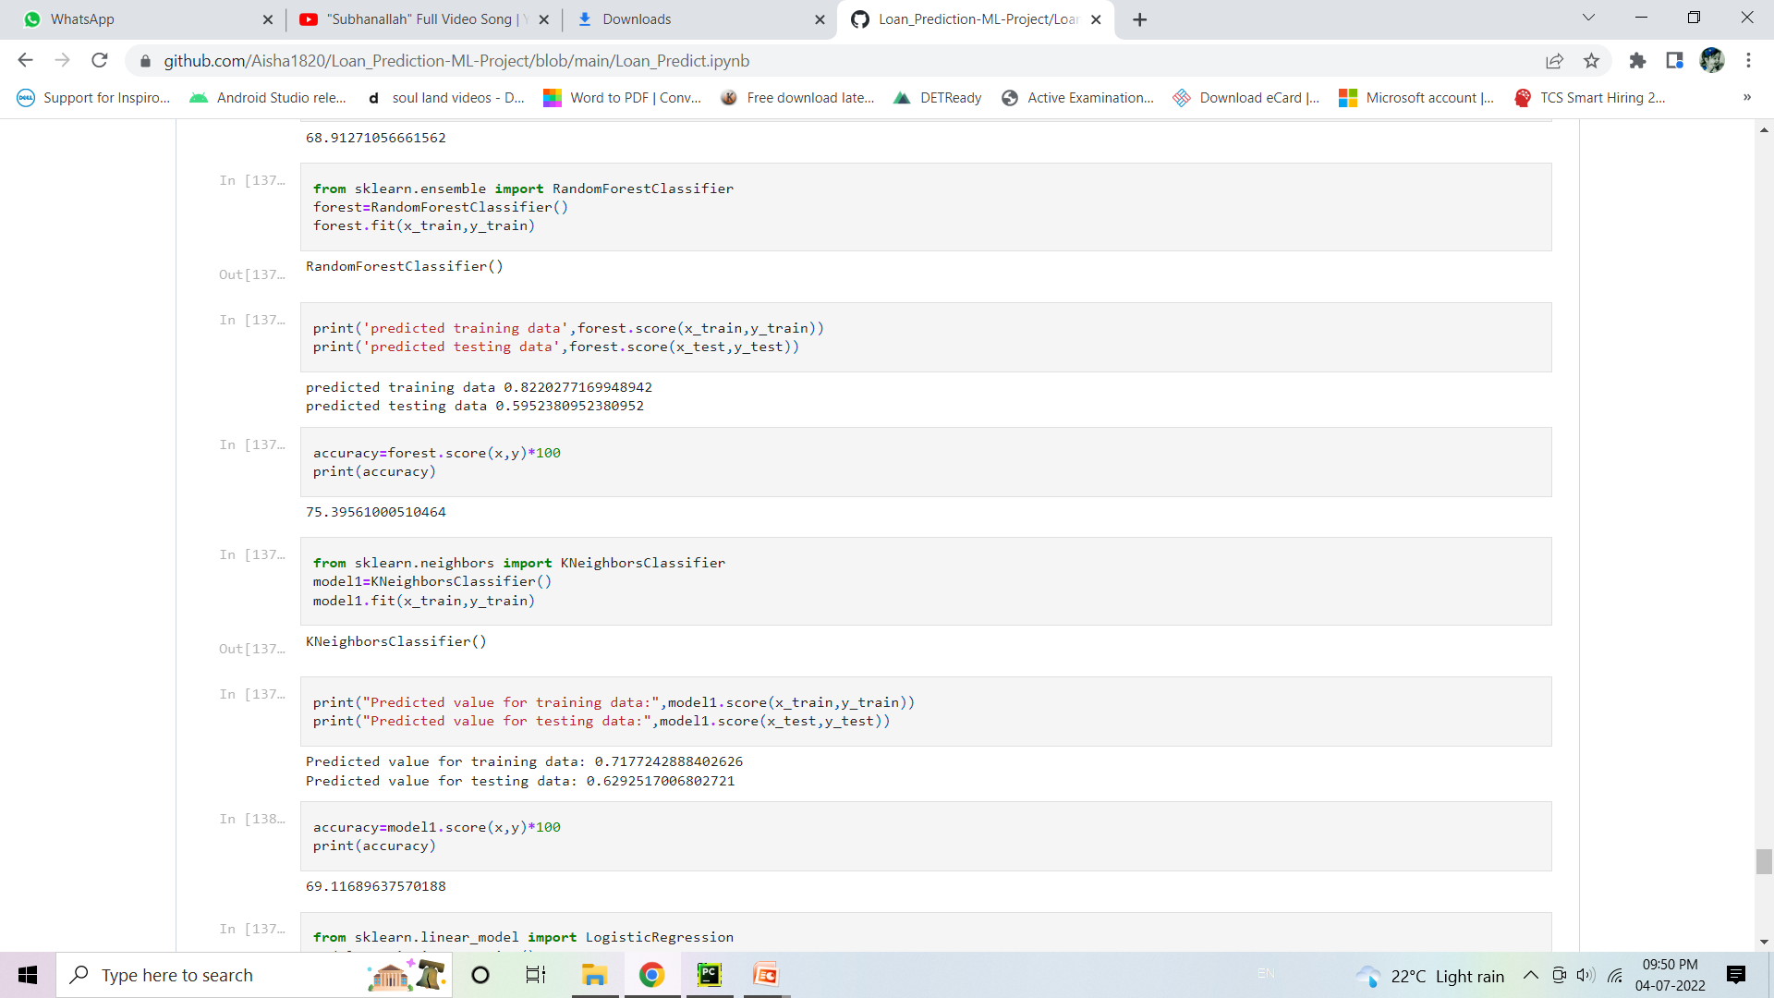
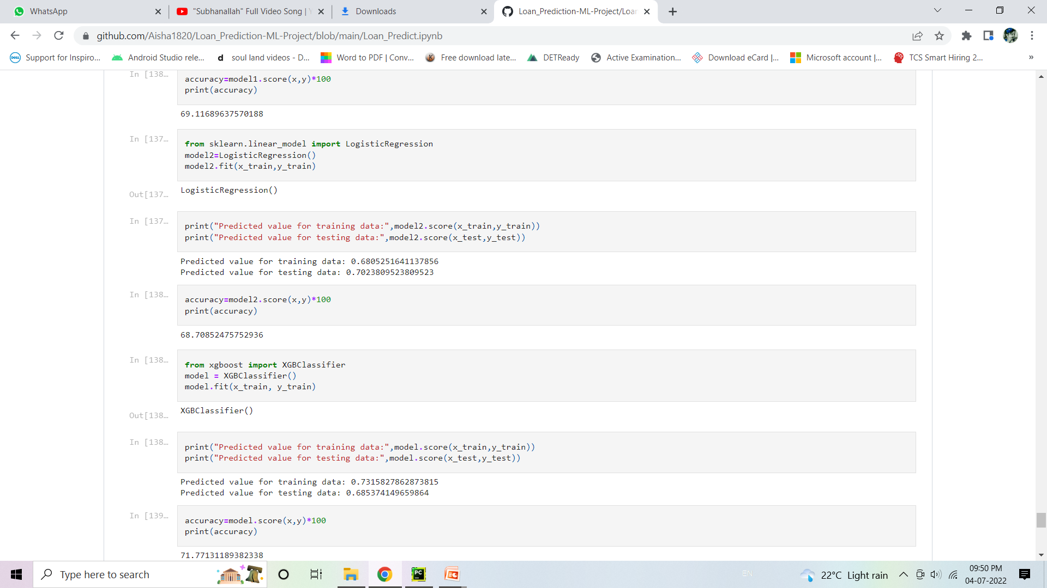

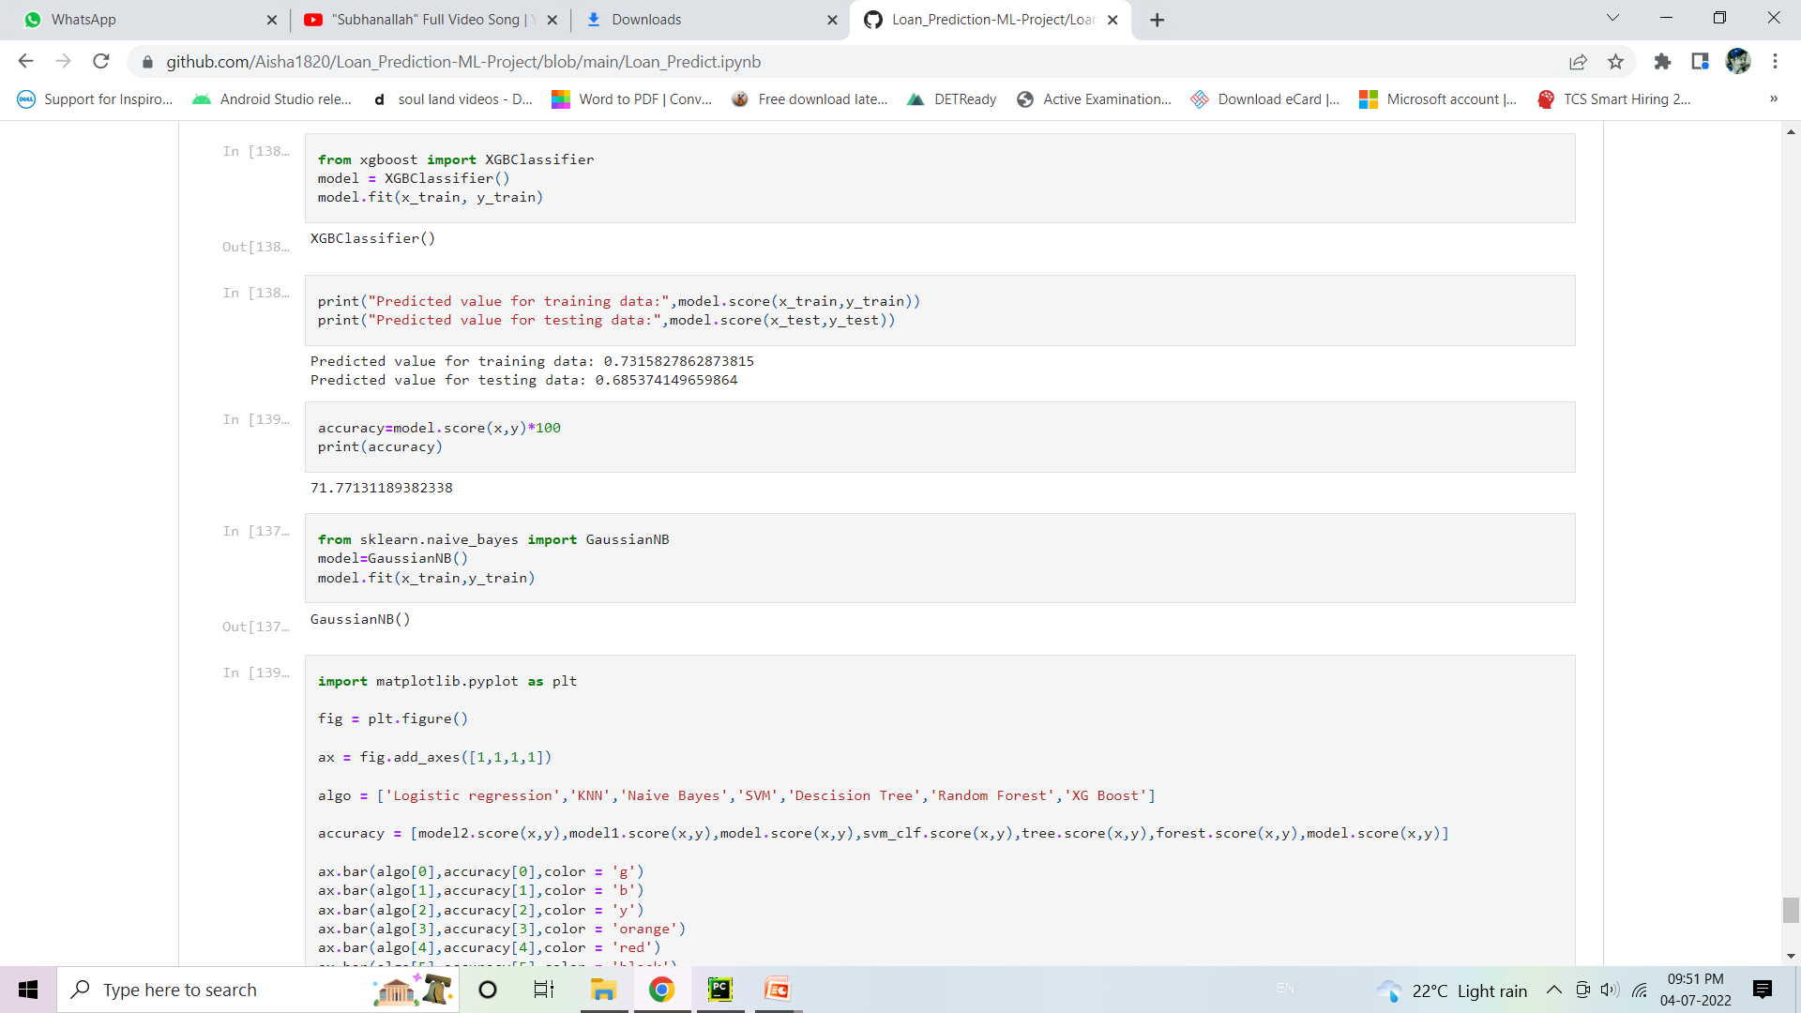
RANDOM FOREST:
LOGISTIC REGRESSION:
K-NEAREST NEIGHBOR:
XG-BOOST:

Slide 9
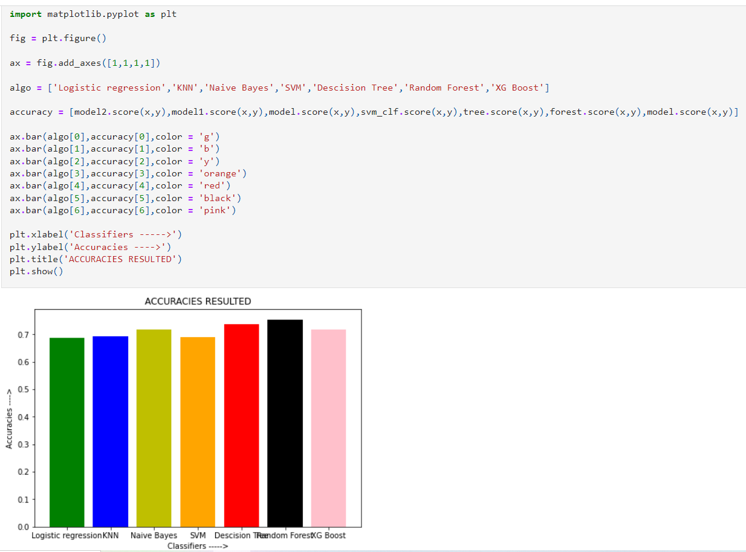

Slide 10
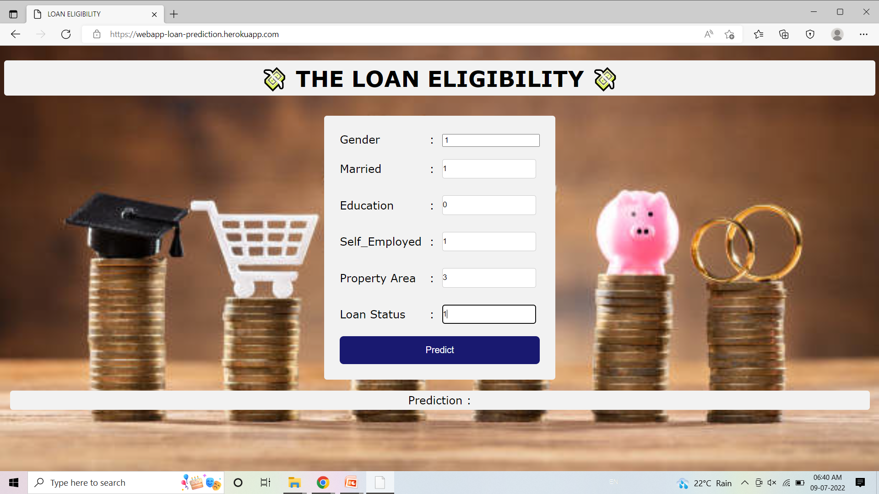

PROJECT DEPLOYMENT
Done with a phase of your project? Let’s go ahead and see how the project is deployed.
Predicting Using 0/1 :
OUTPUT:

Slide 11

HOSTING ON CLOUD
Done with deployment? Have you hosted it on cloud? Hmmm, let’s get to see it
Heroku Cloud: https://webapp-loan-prediction.herokuapp.com

Slide 12
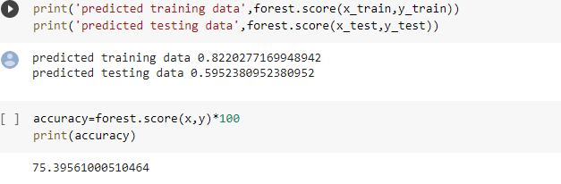
RESULTS
Add your final results i.e the output of your project here.
[Random Forest model with highest accuracy]

Slide 13
USE CASES
Done with the project? Let’s see more use case scenarios widely.
This application can be used based on applicants, who are eligible for Loan.

Slide 14
EXTENSION OF PROJECT
Want to extend your project? Let’s get into details on how we can take it to the next phase.

Slide 15
CONCLUSION
Finally, we're delighted to see that Random Forest is the best model that we can use for this classification model .Random forest has the highest Accuracy than other models.
Hence , we could use this model to predict the Loan Eligibility.

Slide 16
SLIDE TITLE
Click here to add information
NOTE: If you are having some extra information, copy this slide and paste it below the slide you want to add information.

